Slide 1
CMU 10-742 Machine Learning in Healthcare
Lecture 23: MLH in the Real World
Adam Berger

Slide 2
Course Logistics
Final Project Poster Session: Tues Dec 3

Slide 3
Lecture Outline
Hippocratic
Keiji
Definitive Healthcare
Parting thoughts

Slide 4
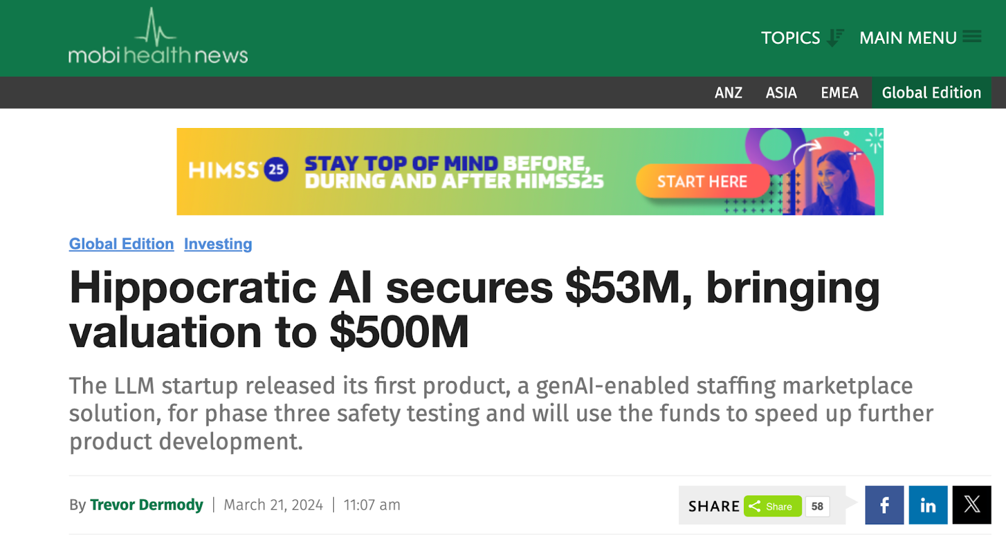
Notes:
V prominent, splash company. $137M raised to date
Jensen Huang highlighted in recent NVIDIA investor conf.
Strong name choice. Hippocratic oath. “Do no harm”

Slide 5
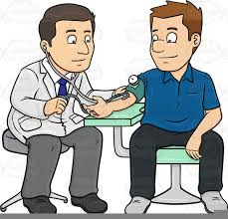
What Do Care Managers Do?
Notes:
Care managers: BETWEEN clinical encounters ("interstitial" care)
100K’s of them in US
Kind of the dark matter of healthcare. We have not talked about this in the course.

Slide 6
What Do Care Managers Do?
When | Example
Post-discharge | Check-in with patient 7d after leaving hospital after MI
(Ongoing) chronic disease | Check-in with patient with chronic kidney disease (CKD)
Transitions of care | Check-in after patient discharged from hospital to post-acute care (PAC) facility
Pre-op | Ensure patient knows to take necessary steps before colonoscopy appointment
Care gaps | Alert patient to schedule flu vaccine (or mammography or…)
Notes:
examples
What's in common - non diagnostic, typically phone-based

Slide 7
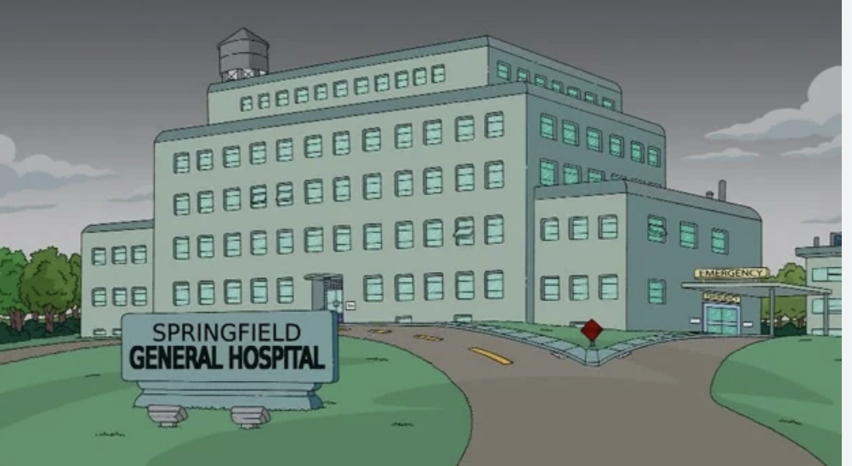
Example
Philip, a care manager at Springfield General, calls Homer 48h after Homer was discharged after his gall bladder surgery.
Steps:
Check on pain
Check on meds
Check on incision area
Check on digestion
Check on mobility
Set followup appointment

Slide 8
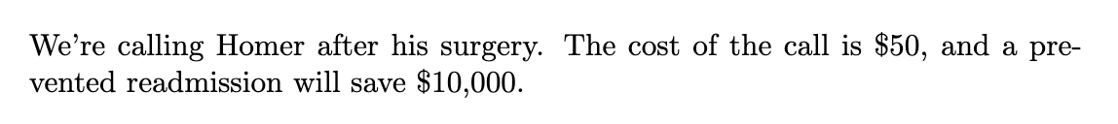
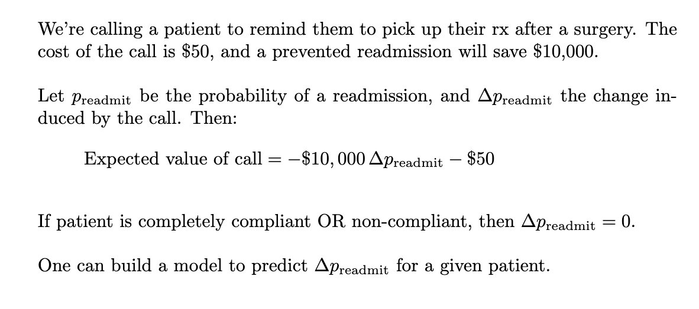
ROI Modeling

Slide 9
ROI Modeling

Slide 10
ROI Modeling

Slide 11
ROI Modeling
Notes:
Imagine the patient is going to completely ignore anything a care mgr says when they call ('non-compliant'). What would delta be?
Now imagine the patient is already going to do everything to care mgr says, what would delta be?

Slide 12
ROI Modeling
Notes:
What you can actually do (what health plans do a lot) is build a model for delta p, so you decide whom to call.

Slide 13
At $50/call
A healthy 33-year old who hasn’t got her flu shot yet
Opportunities for care management
Calls for which expected value > 0
Notes:
Let’s look at this graphically.
Would be nice if the green area were bigger.

Slide 14
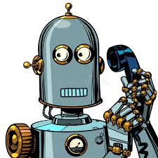
Enter Hippocratic
…autonomous generative AI healthcare agents that can safely converse with patients on medical topics

Slide 15
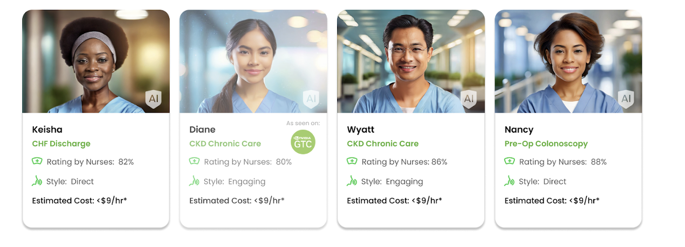
Notes:
Nurses typically $50 - $100/hr
These are not real people. Avatars. STT.

Slide 16
At $0.05/call
A healthy 33-year old who hasn’t got her flu shot yet
Calls for which expected value > 0
Notes:
Hippcratic: they call it “super-staffing”

Slide 17
demo
https://vimeo.com/1020044938
Notes:
https://vimeo.com/1020044938

Slide 18
Training
Pre-training
Train on care plans, healthcare regulatory documents, medical manuals, drug databases, etc.
Learn general clinical knowledge

Slide 19
Training
Pre-training
Train on care plans, healthcare regulatory documents, medical manuals, drug databases, etc.
Learn general clinical knowledge
Instruction Tuning
Train on many-turn patient-nurse dialogs.
Learn how to talk with a patient

Slide 20
Training
Pre-training
Train on care plans, healthcare regulatory documents, medical manuals, drug databases, etc.
Learn general clinical knowledge
Instruction Tuning
Train on many-turn patient-nurse dialogs.
Learn how to talk with a patient
RLHF
Graded model outputs
Learn how to distinguish (and produce) a good vs. bad response

Slide 21
Training
Pre-training
massive collection of proprietary data including clinical care plans, healthcare regulatory documents, medical manuals, drug databases, and other high-quality medical reasoning documents.
Instruction Tuning
Learn how to talk with a patient in a long conversation
RLHF
Learn how to distinguish (and produce) a good vs. bad response
Notes:
Middle step- they describe in detail in the paper
Q: How might you acquire a large, diverse set of patient-provider discussions?

Slide 22
Generating Training Data
Hire patient actors and RNs
Build a set of “scenario templates”
Actors + RNs loosely act out these scenes
Notes:
A: they create it (helps to have $150M in funding)
Instructions to actors/nurses:
“ok to go on tangent”
“Ok to mispronounce”
“Ok to answer incorrectly” (e.g. lab result for an rx)

Slide 23
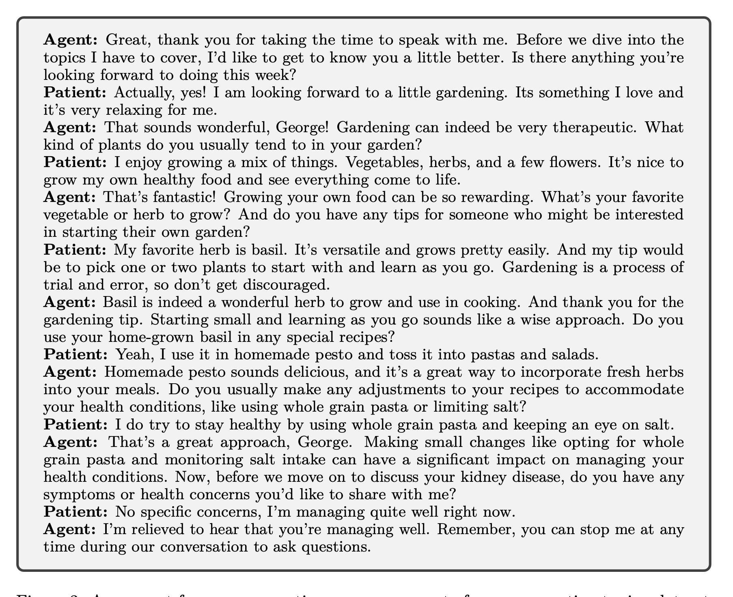
Recorded Scene
Notes:
Example recorded scene (play-acted)

Slide 24
Bootstrapped Training
1. Train model 0 on ‘acted’ dialogs

Slide 25
Bootstrapped Training
1. Train model 0 on ‘acted’ dialogs
2. Use model 0 to produce new dialogs

Slide 26
Bootstrapped Training
1. Train model 0 on ‘acted’ dialogs
2. Use model 0 to produce new dialogs
3. Train model 1 on new dialogs

Slide 27
Bootstrapped Training
1. Train model 0 on ‘acted’ dialogs
2. Use model 0 to produce new dialogs
repeat
3. Train model 1 on new dialogs

Slide 28
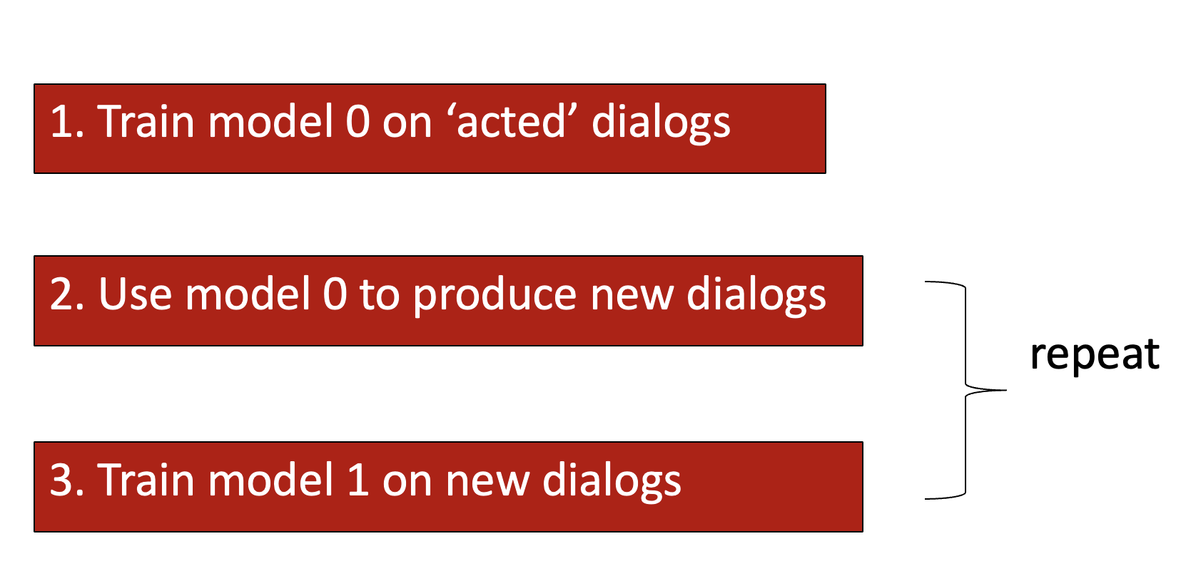
Bootstrapped Training
Any concerns with this?
Notes:
Exposure Bias – difference between training (teacher forcing) and inference
Model 0: teacher forcing
Model 1: pure inference. Can wander off into the weeds.
How to address?
- nurses review model output each stage and adjust/correct.
let model train on a little data it generated, to get used to inference

Slide 29
Evaluation
Recruit >1100 RNs and >130 MDs, as patients.
3,475 encounters
Discard all conversations < 20 turns (~4mins)
Baseline: 60 nurses acting as care manager (instead of Polaris).
Notes:
This was the subjective eval.
They also reported on some other results as well.

Slide 30
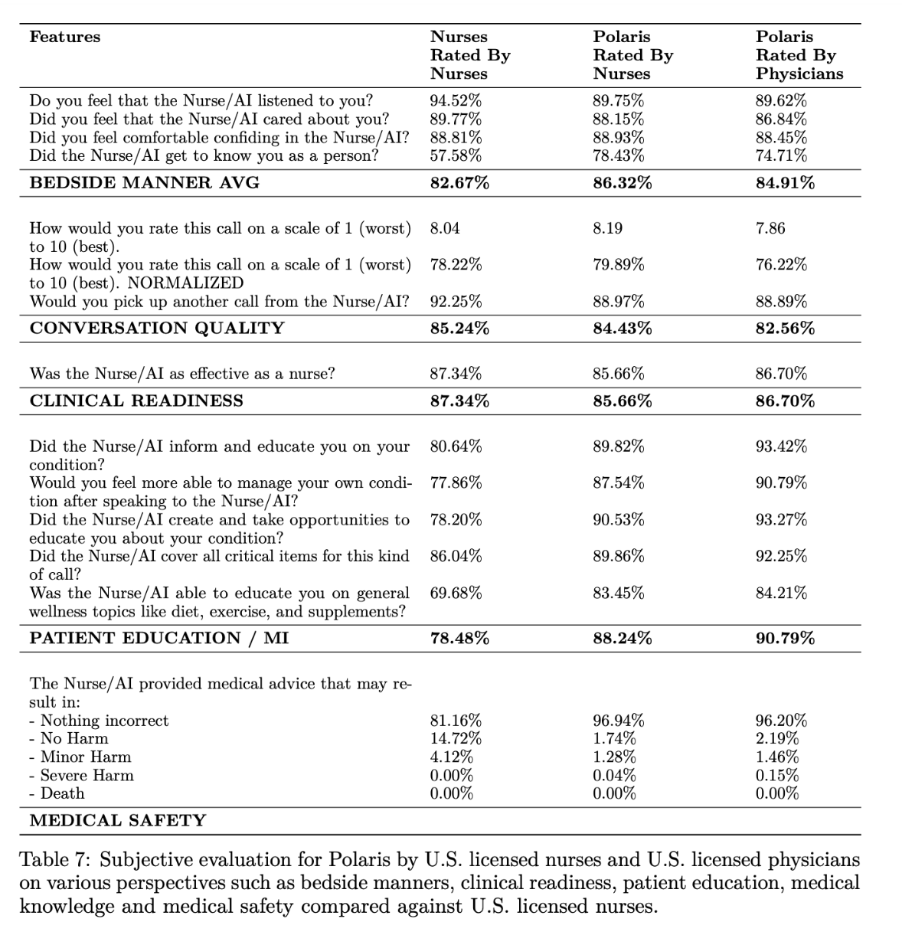
Notes:
Q: concerns w this approach?
On avg, Polaris > nurse, but the key measure might not be how well does it perform on avg, but does it ever fail catastrophically?).
I.e. an elevator that is faster on average but 1x/1000 it crashes and kills a passenger

Slide 31
Lecture Outline
Hippocratic
Keiji
Definitive Healthcare
Parting thoughts
Notes:
Keiji – in clinical trial space

Slide 32
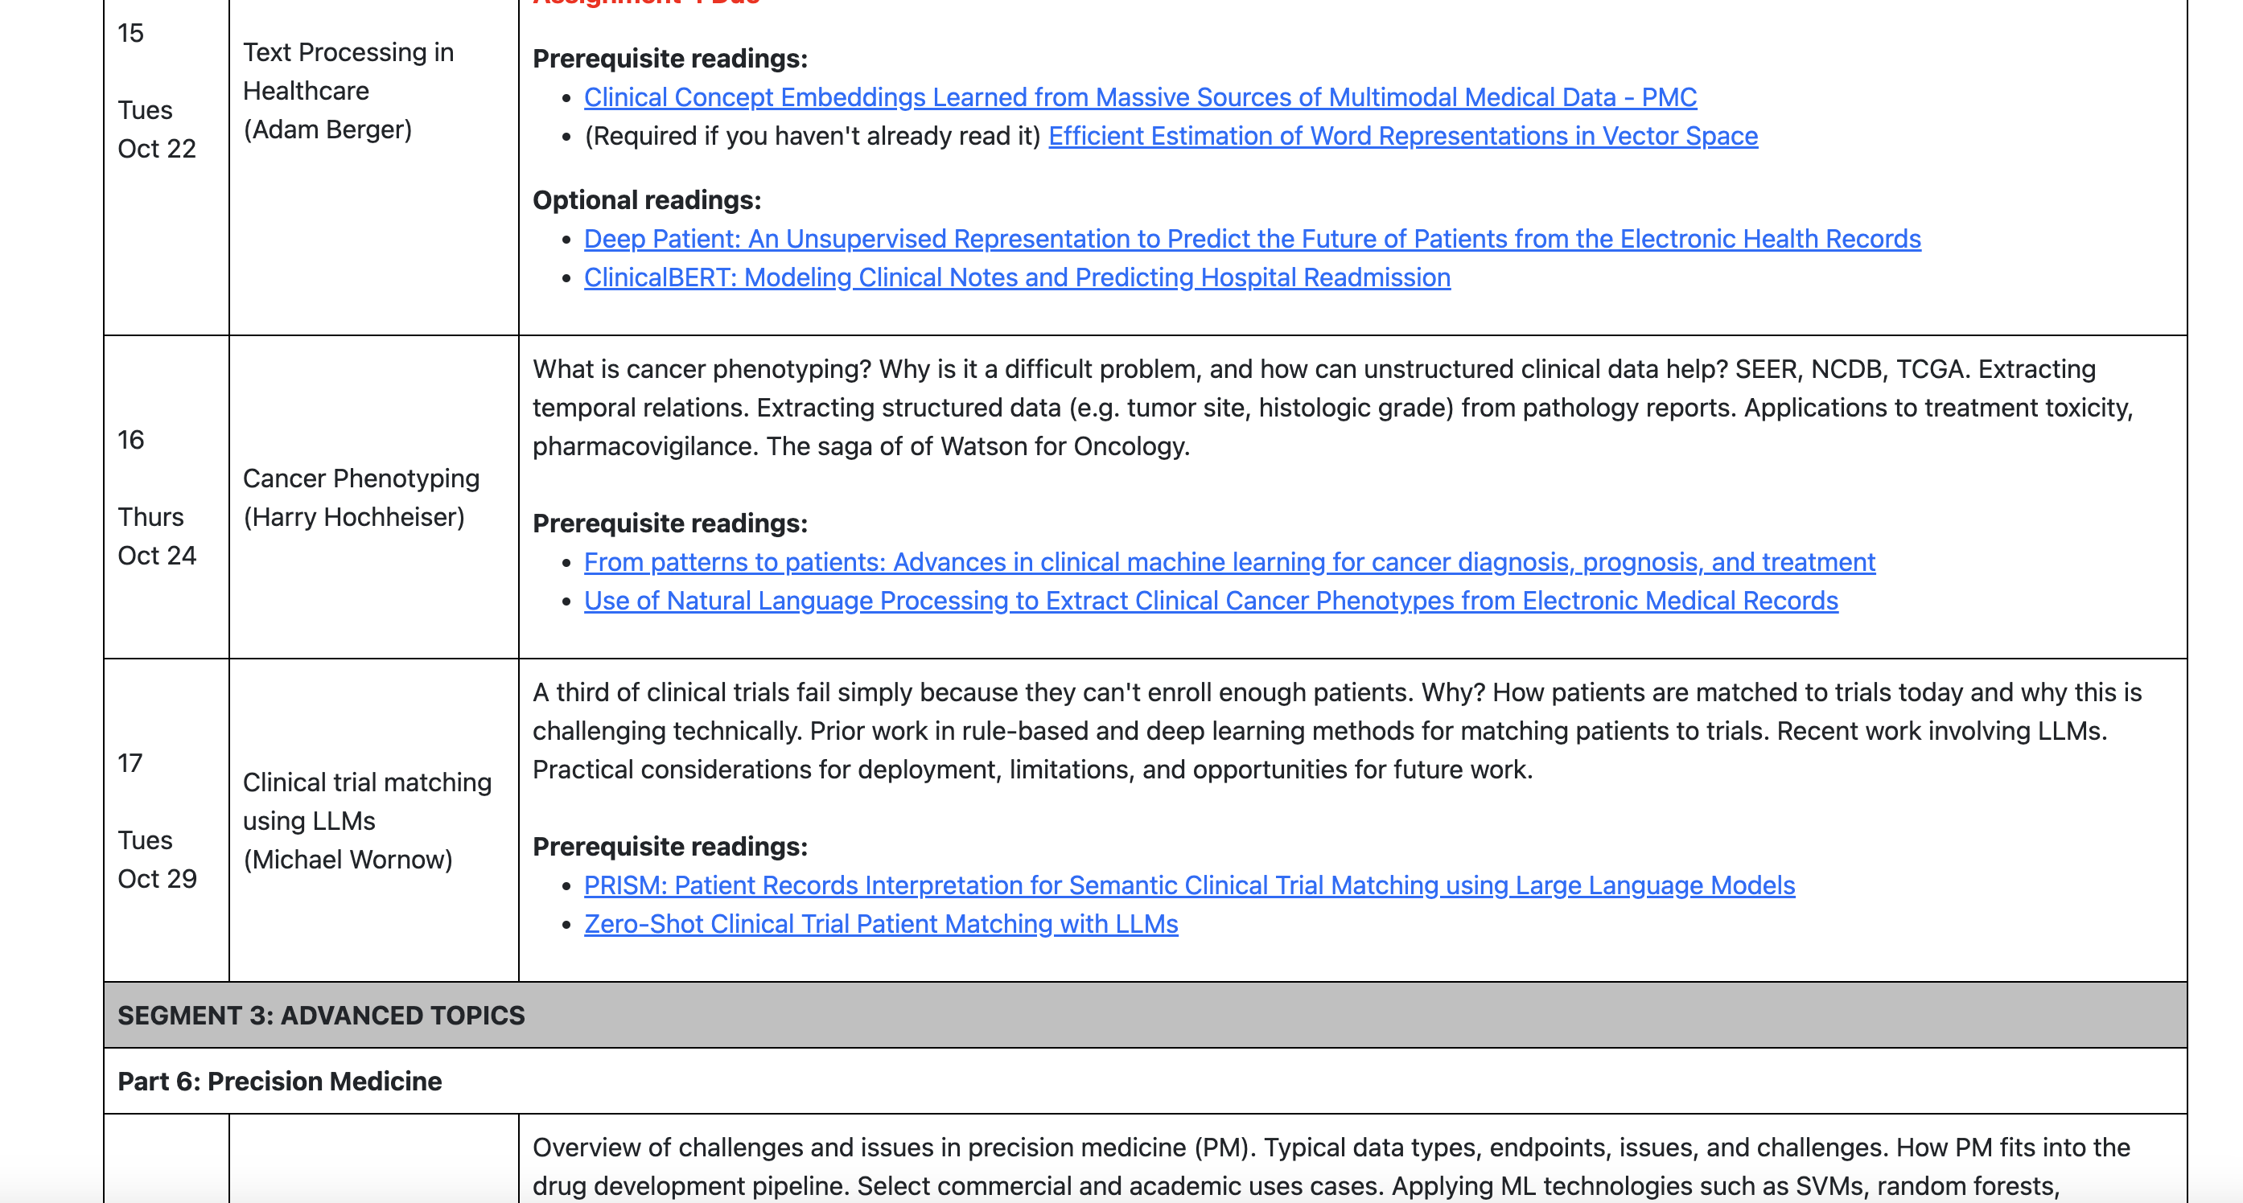
Wait, Didn’t We Study AI+Clinical Trials Already?
Notes:
(lek 17)

Slide 33
Protocol development
Inclusion/exclusion criteria. Trial design. Endpoint selection. Timeline. Trial size. etc.
Site Selection
review past performance, eligible patient density, etc.
.
Planning/Setup
IRB approval,staff training.
Patient Identification
Select candidate patients
Pre-screening
initial call, Medical record review, basic eligibility check.
Detailed screening
check detailed clinical records, lab tests, retention prediction, informed consent.
.
Patient Retention & Monitoring
reminders, travel coordination, stipends. Adverse event detection.
.
Notes:
what Michael described in lek 17 was matching patients to trials - just one piece (green) of the overall clinical trial process.

Slide 34
Protocol development
Inclusion/exclusion criteria. Trial design. Endpoint selection. Timeline. Trial size. etc.
Site Selection
review past performance, eligible patient density, etc.
.
Planning/Setup
IRB approval, staff training.
Patient Identification
Select candidate patients
Pre-screening
initial call, Medical record review, basic eligibility check.
Detailed screening
check detailed clinical records, lab tests, retention prediction, informed consent.
.
Patient Retention & Monitoring
reminders, travel coordination, stipends. Adverse event detection.
.
Notes:
Yellow – where ML might apply

Slide 35
Protocol development
Inclusion/exclusion criteria. Trial design. Endpoint selection. Timeline. Trial size. etc.
Site Selection
review past performance, eligible patient density, etc.
.
Planning/Setup
IRB approval,staff training.
Patient Identification
Select candidate patients
Pre-screening
initial call, Medical record review, basic eligibility check.
Detailed screening
check detailed clinical records, lab tests, retention prediction, informed consent.
.
Patient Retention & Monitoring
reminders, travel coordination, stipends. Adverse event detection.
.
Notes:
Green – one place where Keiji focuses (“upstream of clinical trial matching”)

Slide 36
Eroom’s Law

Slide 37
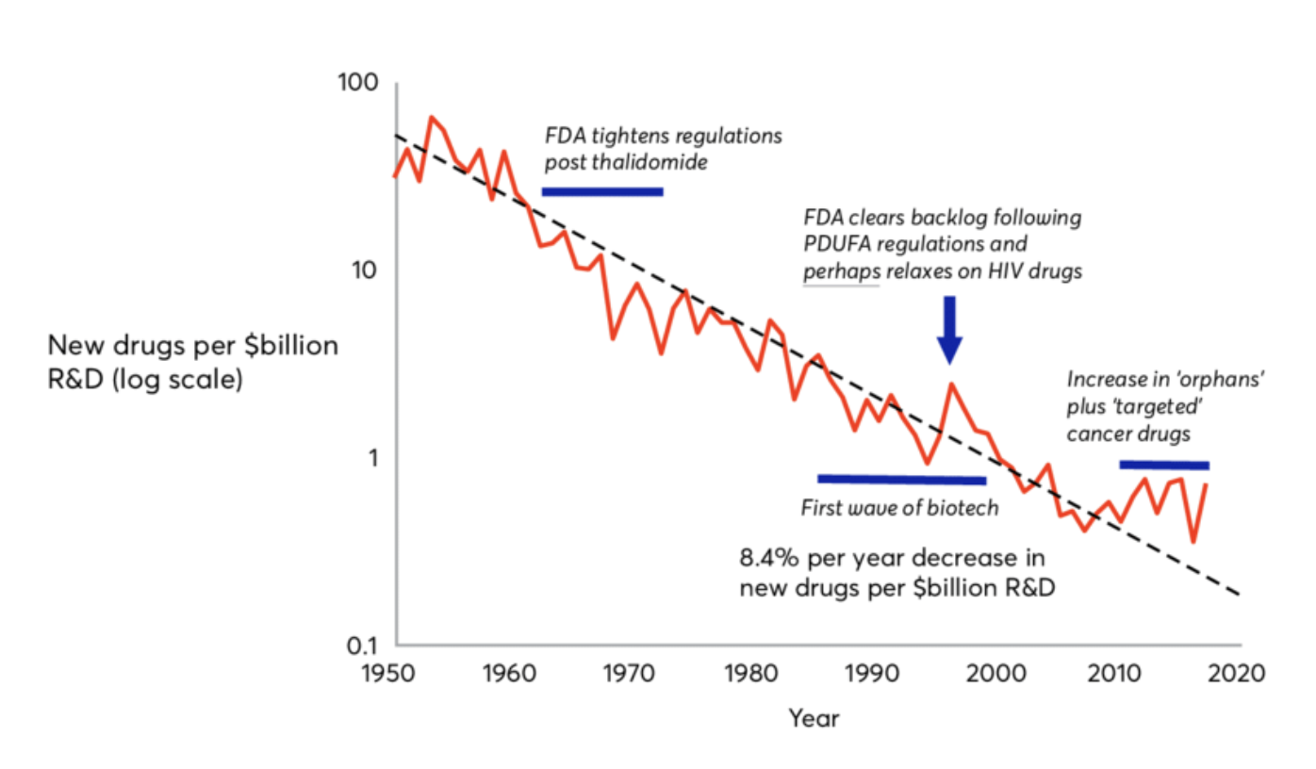
Eroom’s Law
https://www.researchgate.net/figure/Erooms-law-the-number-of-new-molecules-approved-by-the-US-Food-and-Drug-Administration_fig4_326479089
Notes:
Over the previous 60 years, the number of drugs approved in the United States per billion dollars in R&D spending had halved every nine years. It can now take more than a billion dollars in funding and a decade of work to bring one new medication to market.
THIS is why trial design/optimization is important
(Thalidomide – crossed placental barrier)

Slide 38
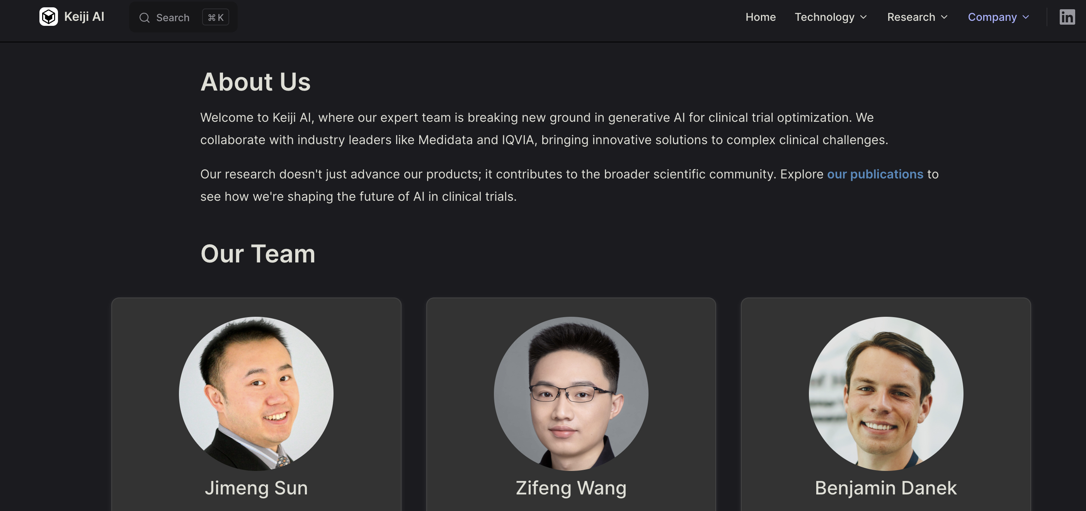
Notes:
Jimeng – PhD in CS from CMU in 2007
KDD best dissertation award (honorable mention)

Slide 39
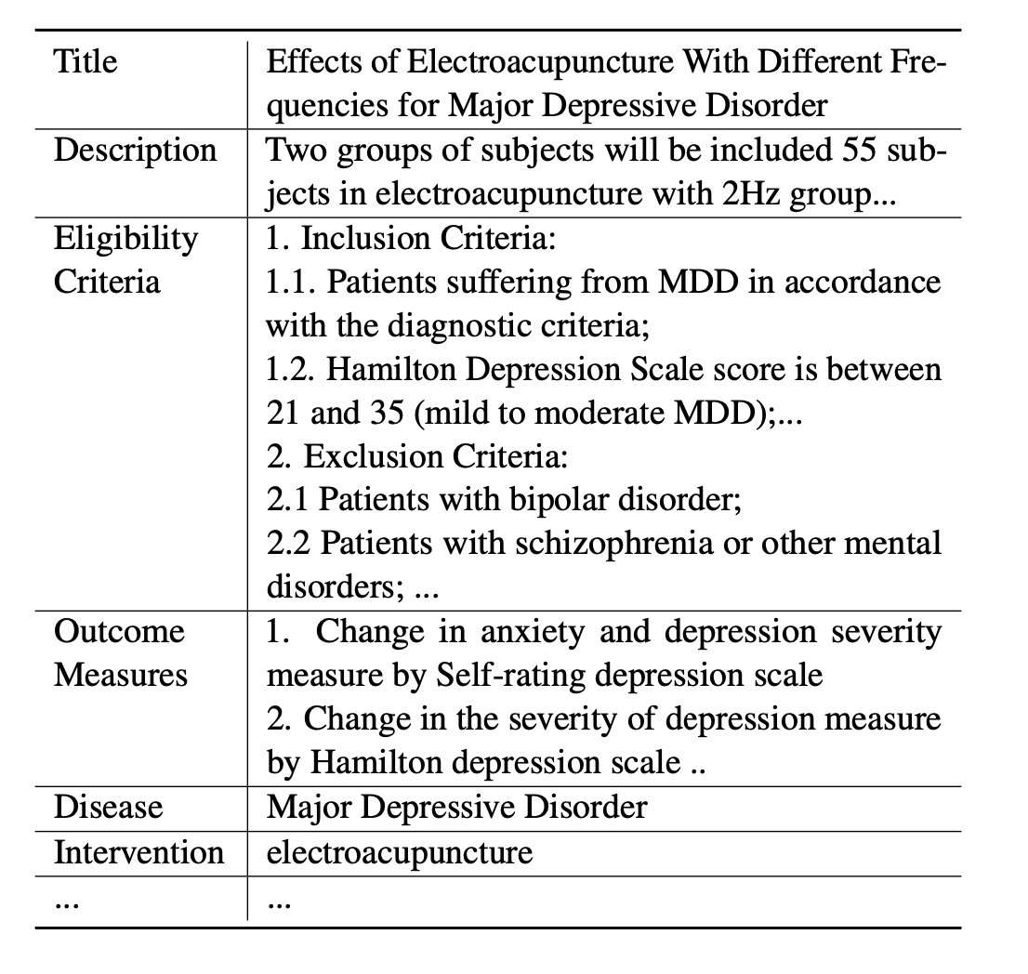
Problem: Optimize Clinical Trial Design
Notes:
”parameters” of a clinical trial:
incl. criteria
Excl. criteria
Sites
# patients
Target (e.g. disease burden, biomarkers, survival, …)

Slide 40
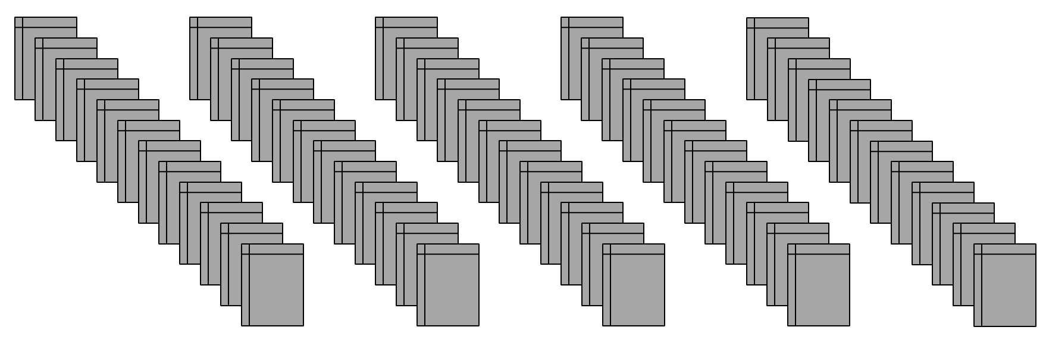
Problem: Optimize Clinical Trial Design
Candidate trial
Data on 400K historical trials in clinicaltrials.gov
Notes:
How might data from old trials be helpful?
Ok, but how to find the closest matching trials? (IR problem) – could try:
- TFIDF weighted scoring
- Annotate trials w/ metadata and run SQL queries on the metadata
HOW MIGHT YOU DO IT, USING MODERN DL?
Hint: remember in lek 15 we used BERTscore to measure similarity of two documents?

Slide 41
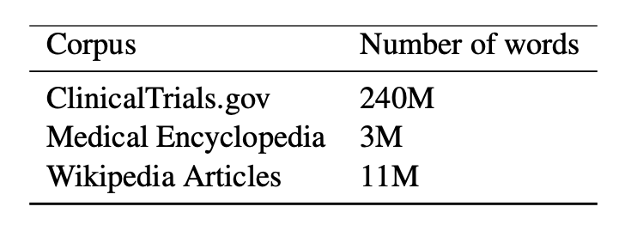
TrialBERT
1. Start with pretrained weights (BioBERT)
2. MLM fine-tuning on ClinicalTrials.gov, Wikipedia articles, etc.
Notes:
TrialBERT: BERT-style model (decoder-only transformer model) customized for clinical trials
***
MLM- masked language model
Leaving out some complexity - actually a hierarchical model

Slide 42
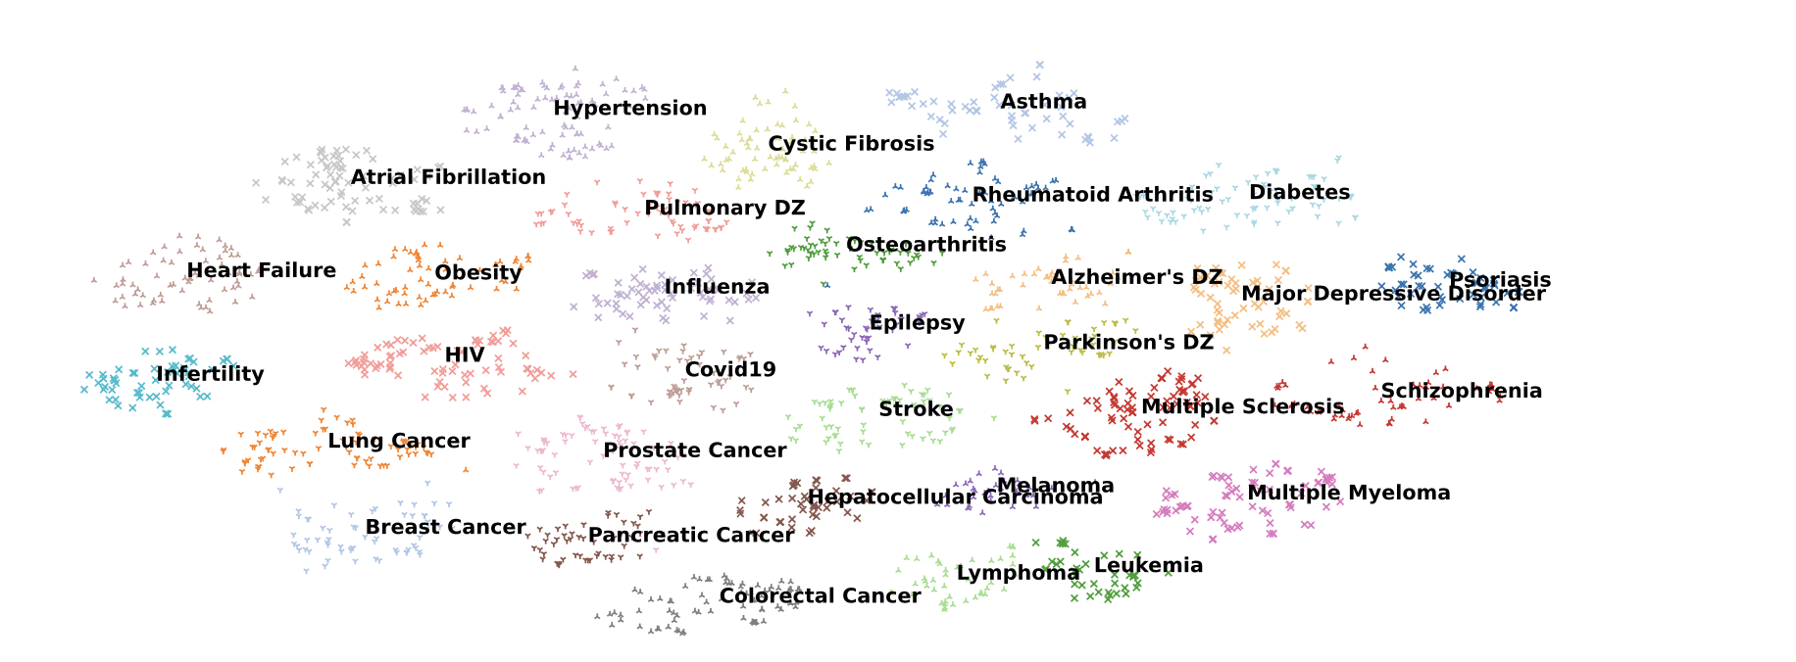
Trial Embeddings
Notes:
When you use trial2vec to create embeddings, you notice (after typical t-SNE dim reduction) that the trials tend to cluster appropriately, which is a nice sanity check.
Trials for a single disease cluster together
Cancers at the bottom
Parkinson’s and Alzheimer’s nearby

Slide 43
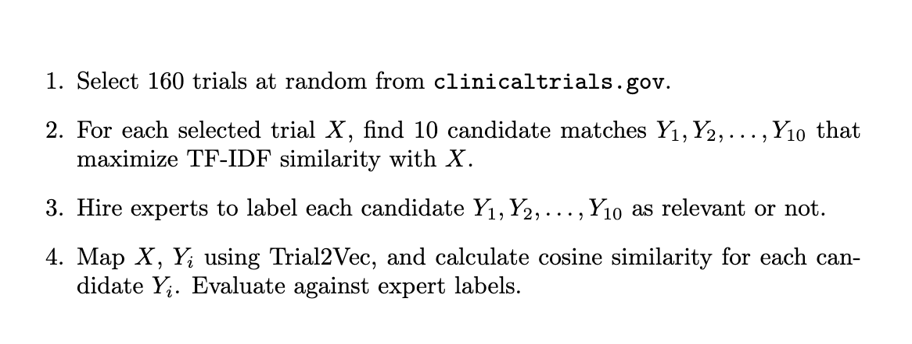
Evaluation
Notes:
Cos similarity between 2 docs

Slide 44
Evaluation
Notes:
TFIDF: term freq in document / term freq in corpus
Doc -> vector of terms, weight by TFIDF
Cos similarity between 2 docs

Slide 45
Evaluation
Notes:
Issues with this? (TFIDF introduces bias – the top TFIDF matches are NOT necessarily the most matching trials!)
TFIDF: term freq in document / term freq in corpus
Doc -> vector of terms, weight by TFIDF
Cos similarity between 2 docs

Slide 46
Evaluation
Notes:
Issues with this? (TFIDF introduces bias – the top TFIDF matches are NOT necessarily the most matching trials!)
Cos similarity between 2 docs

Slide 47
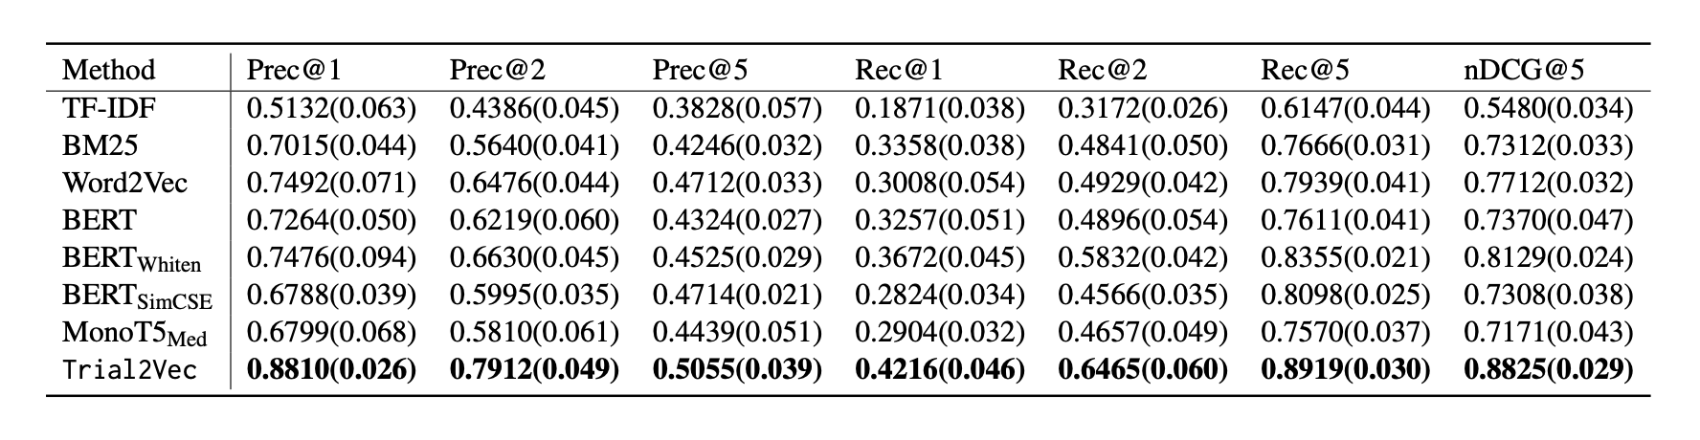
Evaluation
Notes:
Table:
Select 160 trials at random from the 400k
Use TFIDF to rank top-10 matches for each (HUGE BIAS HERE!)
Hire experts (clinicians) to label relevant/irrelevant
See if u can predict

Slide 48
Lecture Outline
Hippocratic AI
Keiji
Definitive Healthcare
Parting thoughts

Slide 49
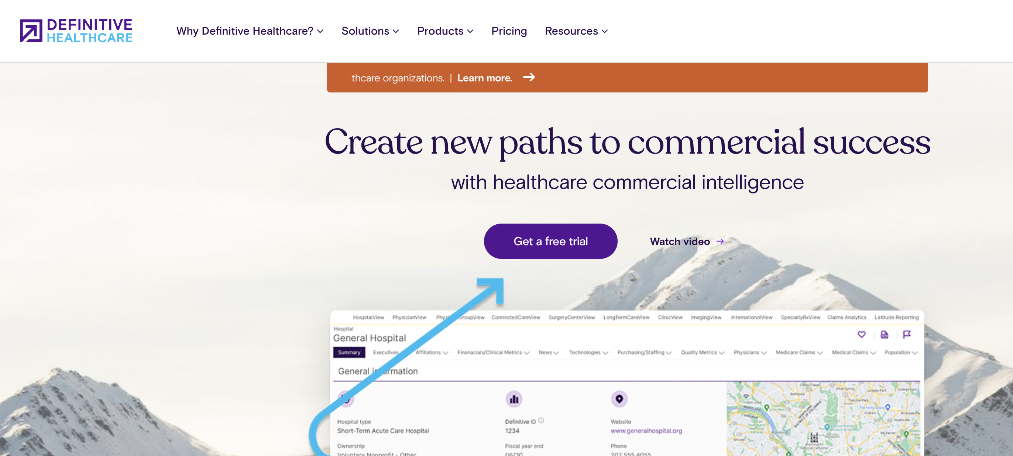
Notes:
Publicly held
Aggregates data on providers, hospitals, patients and sells that data + tools to use that data
Q: Why might companies pay for this data?

Slide 50
Why is this data (commercially) useful?
Why am I seeing leakage in my network in pediatric primary care?
Should I grow my provider network in Armstrong County?
Should I hire more orthopedists?
How should I price my new gene therapy for lupus?
Would Boston or Cleveland be a better place to market our lower back surgery services?
Notes:
(examples)

Slide 51
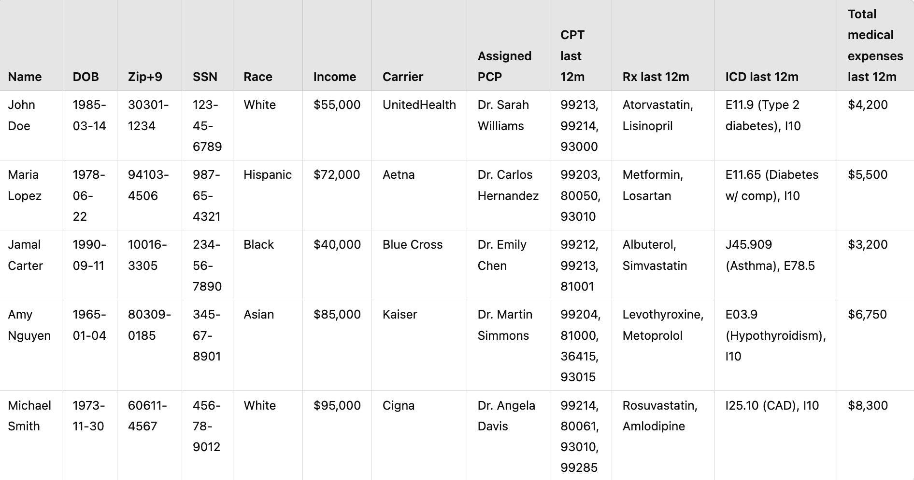
demographic
clinical
Notes:
First step: Definitive gathers all this data on people, from various sources

Slide 52
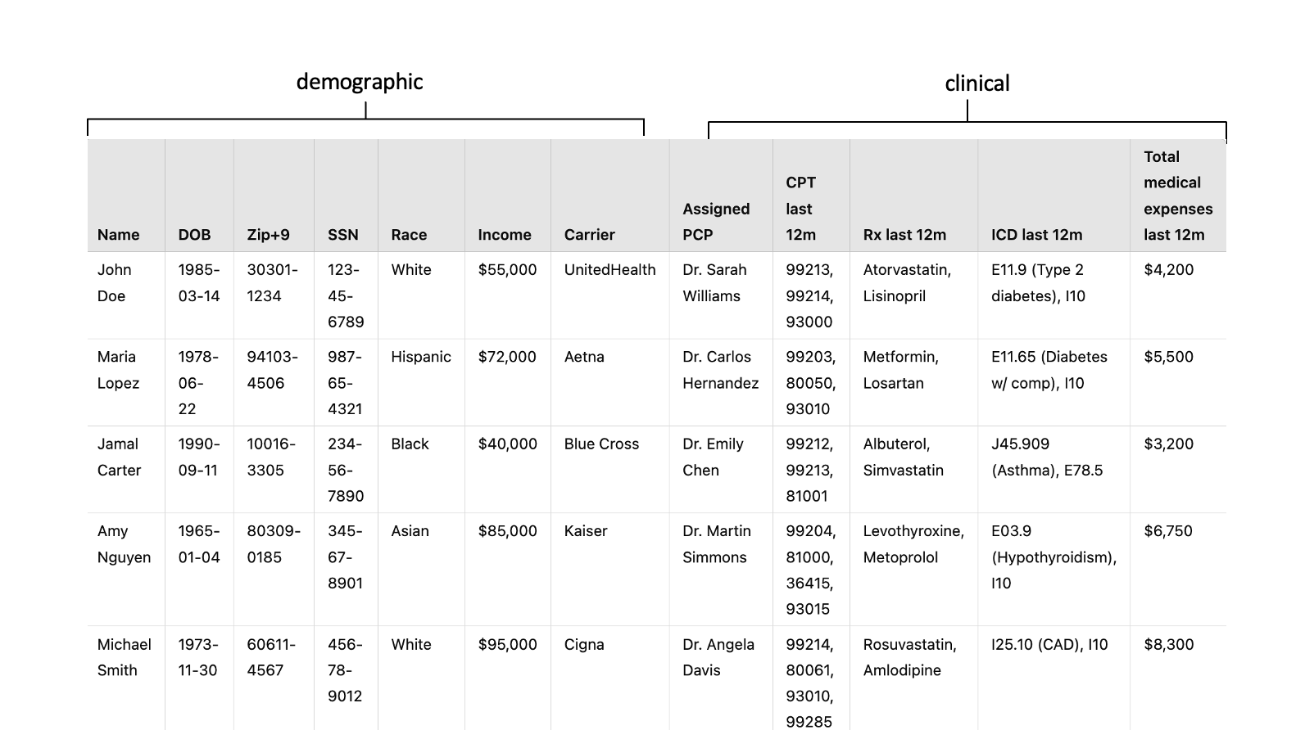
Census: Age, gender, marital status, …
Experian: credit history
Mastercard: retail purchase history
Lexis/Nexis: SDOH (poverty index, etc.)
Notes:
Where does that data come from?
(sources of data)

Slide 53
EHR: dx, allergies, immunizations..
Claims: CPT, ICD, costs
Pharmacy: rx, adherence
Labs: tests and results

Slide 54
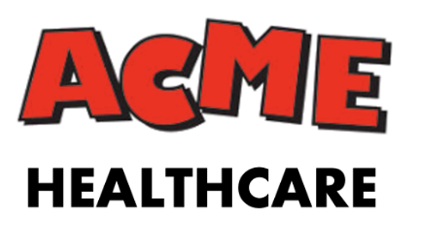
Example Customer
ACME Healthcare just opened a brand-new orthopedic surgery center. Now they want more patients.
They’ve decided to buy Facebook ads, targeting people who are likely to need a knee replacement in the next 2 years.
How might Definitive help them do that?
Notes:
How do they make $.
GREAT! Definitive has a nationwide database of claims and clinical data
Can Definitive just give ACME a list of all patients who have had recent knee MRI, say?
No. (but not b/c of HIPAA - not a CE or BA). Other laws, DUAs, etc.
So what can we do?

Slide 55
Select Target Variable
Diabetes?
1
1
0
0
0
Notes:
This is where propensity modeling comes in. L
1st step: define target variables, e.g. ‘has diabetes’
Others: ‘takes metformin’, ‘pays > $10K in medical expenses’ , ‘had an MRI recently’, etc.

Slide 56
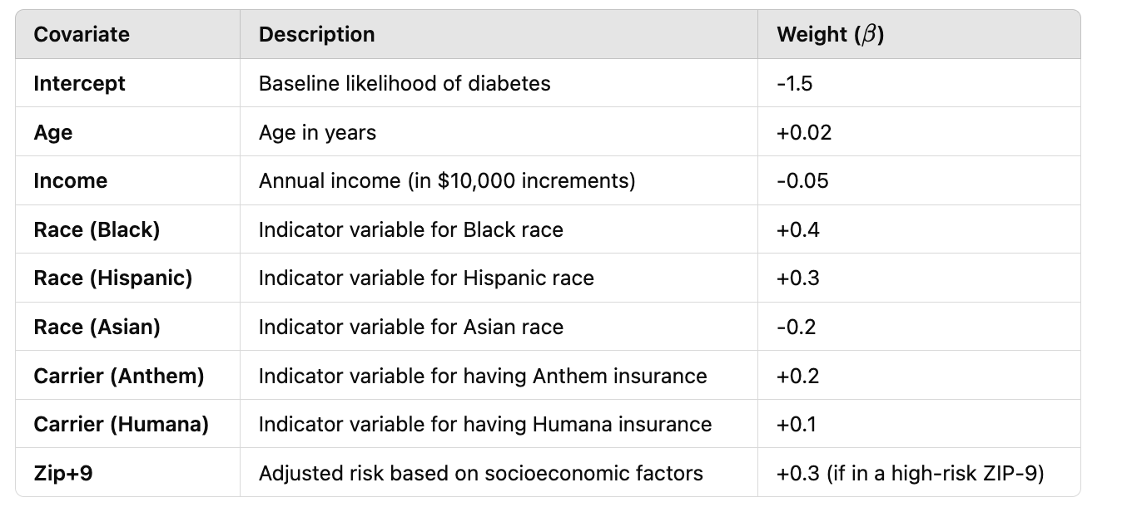
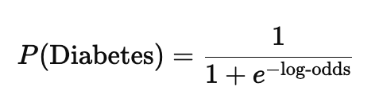
Build Propensity Model
Notes:
Log-reg in this case
Could instead be Xgboost, Neural model, You name it
Notice we’re ONLY using covariates from the consumer data. (Why?)

Slide 57
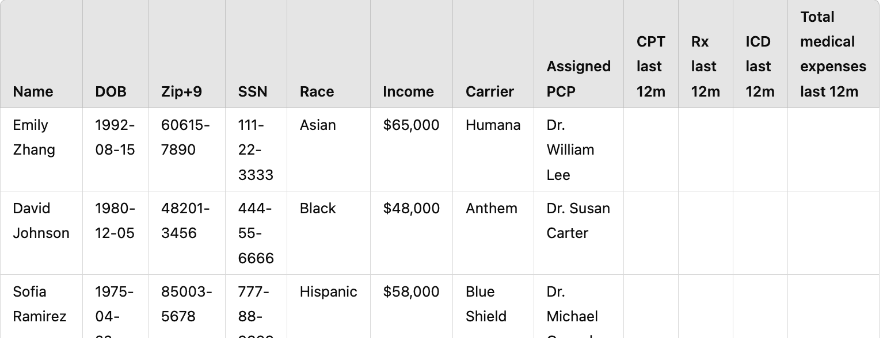
Inference
P(diabetes)
0.66
0.12
0.05
Apply model
Notes:
Now time to use the model
Target the first one for web ads around diabetes

Slide 58

Example Customer
List of people with high propensity for knee replacement surgery
I want people likely to require a knee replacement
Apply propensity model
Notes:
Ok, now Definitive has a propensity model, for patients likely to need knee replacement surgery
ACME gives the criteria to Definitive, it applies that to all its known patients and scores each

Slide 59
Lecture Outline
Hippocratic
Keiji + Trial Pathfinder
Definitive Healthcare
Parting Thoughts

Slide 60
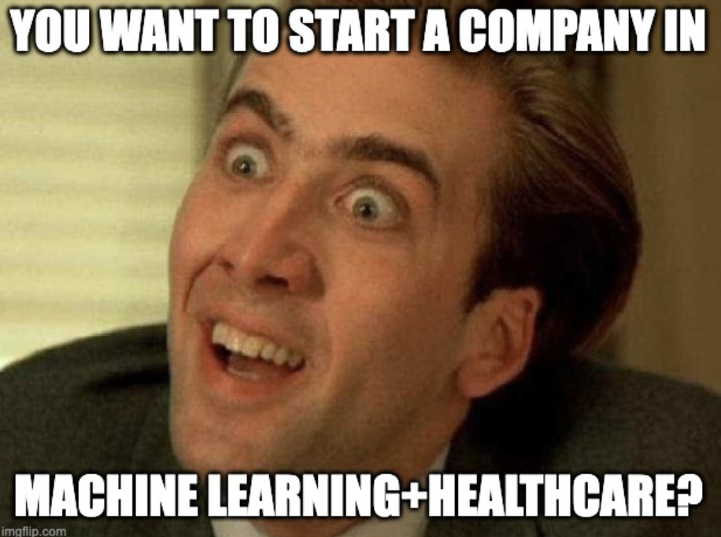

Slide 61
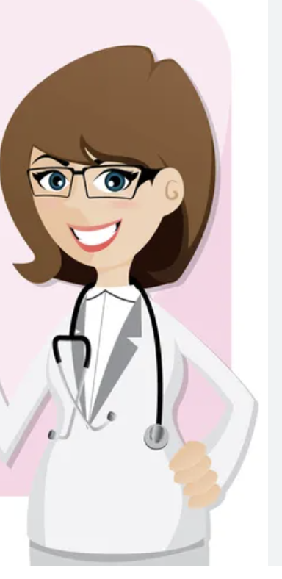
Lesson 1: Select Your Business Model Carefully
Dr. Iris Bennett has built a model that, from a retinal image, identifies patients likely to contract diabetes.
Next few slides courtesy https://www.bvp.com/atlas/roadmap-healthcare-ai
Notes:
Assume: 20K ophthalmologists, 50K optometrists, 18M retinal images evert year 7M ocular injections each year

Slide 62
Lesson 1: Select Your Business Model Carefully
Dr. Iris Bennett has built a model that, from a retinal image, identifies patients likely to contract diabetes
Optometrists and ophthalmologists can bill for this code:
CPT Code 92229: Imaging of retina for detection or monitoring of disease; point-of-care automated analysis and report, unilateral or bilateral.
How should she sell this?
https://www.bvp.com/atlas/roadmap-healthcare-ai

Slide 63
Lesson 1: Select Your Business Model Carefully
Dr. Iris Bennett has built a model that, from a retinal image, identifies patients likely to contract diabetes
Optometrists and ophthalmologists can bill for this code:
CPT Code 92229: Imaging of retina for detection or monitoring of disease; point-of-care automated analysis and report, unilateral or bilateral.
How should she sell this?
Slides in this section derived from Bessemer Venture Partners – see https://www.bvp.com/atlas/roadmap-healthcare-ai

Slide 64
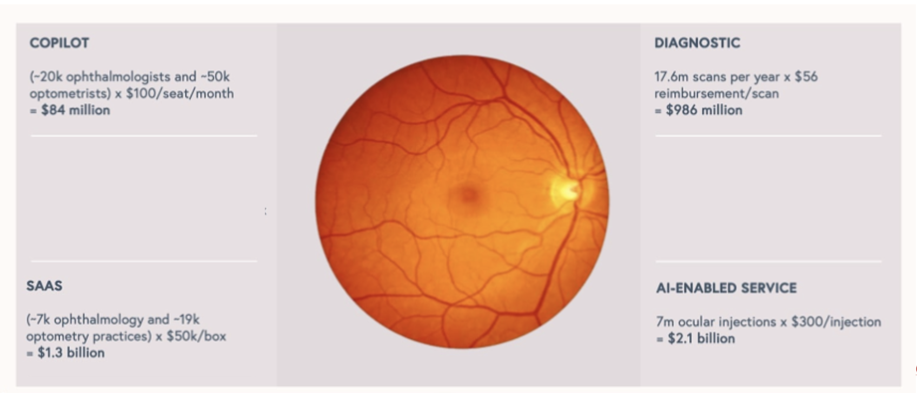

Assume: 20K ophthalmologists, 50K optometrists, 18M retinal images evert year 7M ocular injections each year
https://www.bvp.com/atlas/roadmap-healthcare-ai

Slide 65
Assume: 20K ophthalmologists, 50K optometrists, 18M retinal images evert year 7M ocular injections each year
https://www.bvp.com/atlas/roadmap-healthcare-ai

Slide 66
Assume: 20K ophthalmologists, 50K optometrists, 18M retinal images evert year 7M ocular injections each year
https://www.bvp.com/atlas/roadmap-healthcare-ai

Slide 67
Assume: 20K ophthalmologists, 50K optometrists, 18M retinal images evert year 7M ocular injections each year
https://www.bvp.com/atlas/roadmap-healthcare-ai

Slide 68
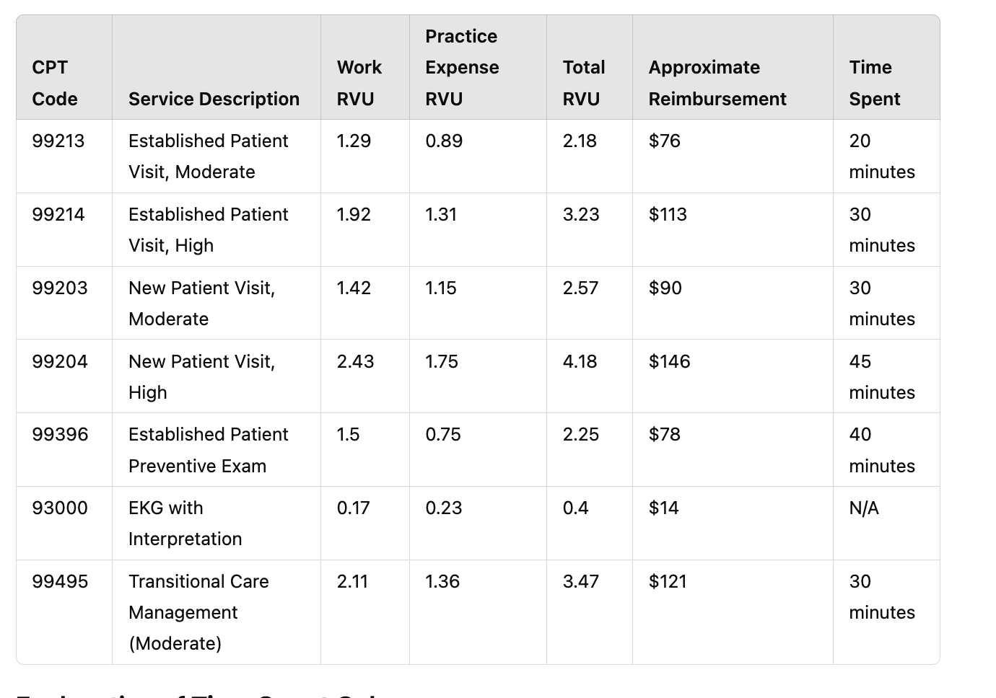
Lesson 2: Efficiency Doesn’t (Always) Sell
Notes:
Insurers (incl. CMS) generally pay providers on RVUs. Which is time-based.
Some examples here

Slide 69
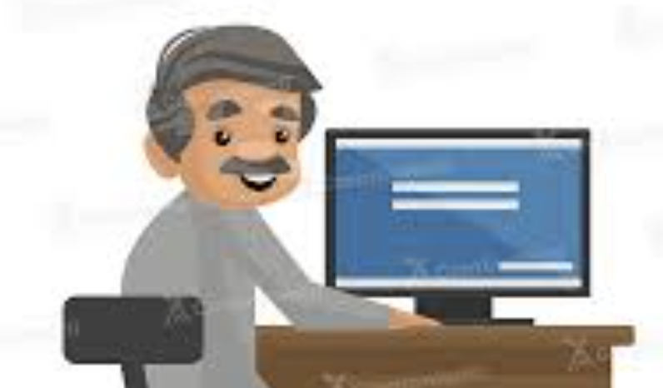
Kiran has invented a DocGPT that can perform TCM automatically.
Notes:
Is anyone going to buy this? Why or why not?
(Mention APCM)

Slide 70
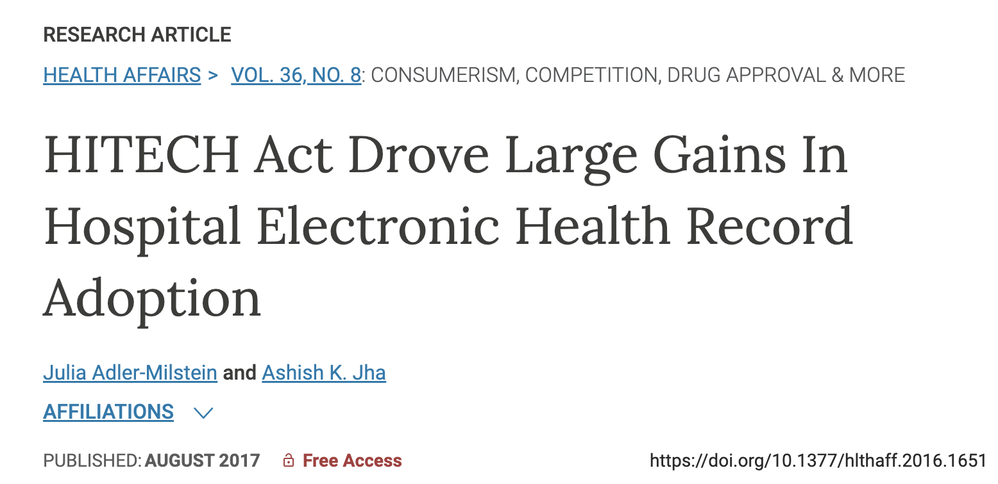
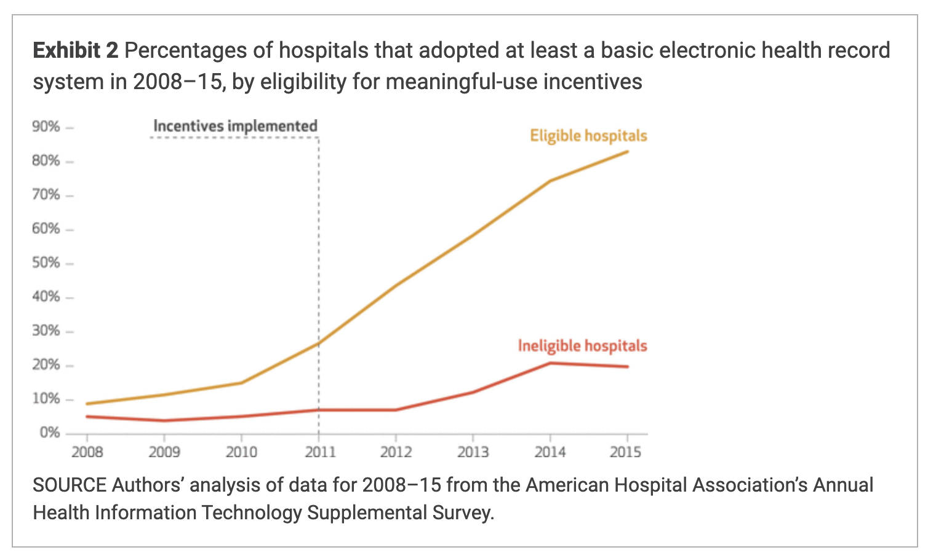
Lesson 3: Monitor Regulatory Changes
Notes:
(Recall: Lek 4 - we discussed HiTech Act – 2009 – which kickstarted MLH )
Eligible: general and medical-surgical acute care hospitals as eligible for meaningful-use incentives
Ineligible: long-term acute care, psychiatric, and rehabilitation hospitals

Slide 71
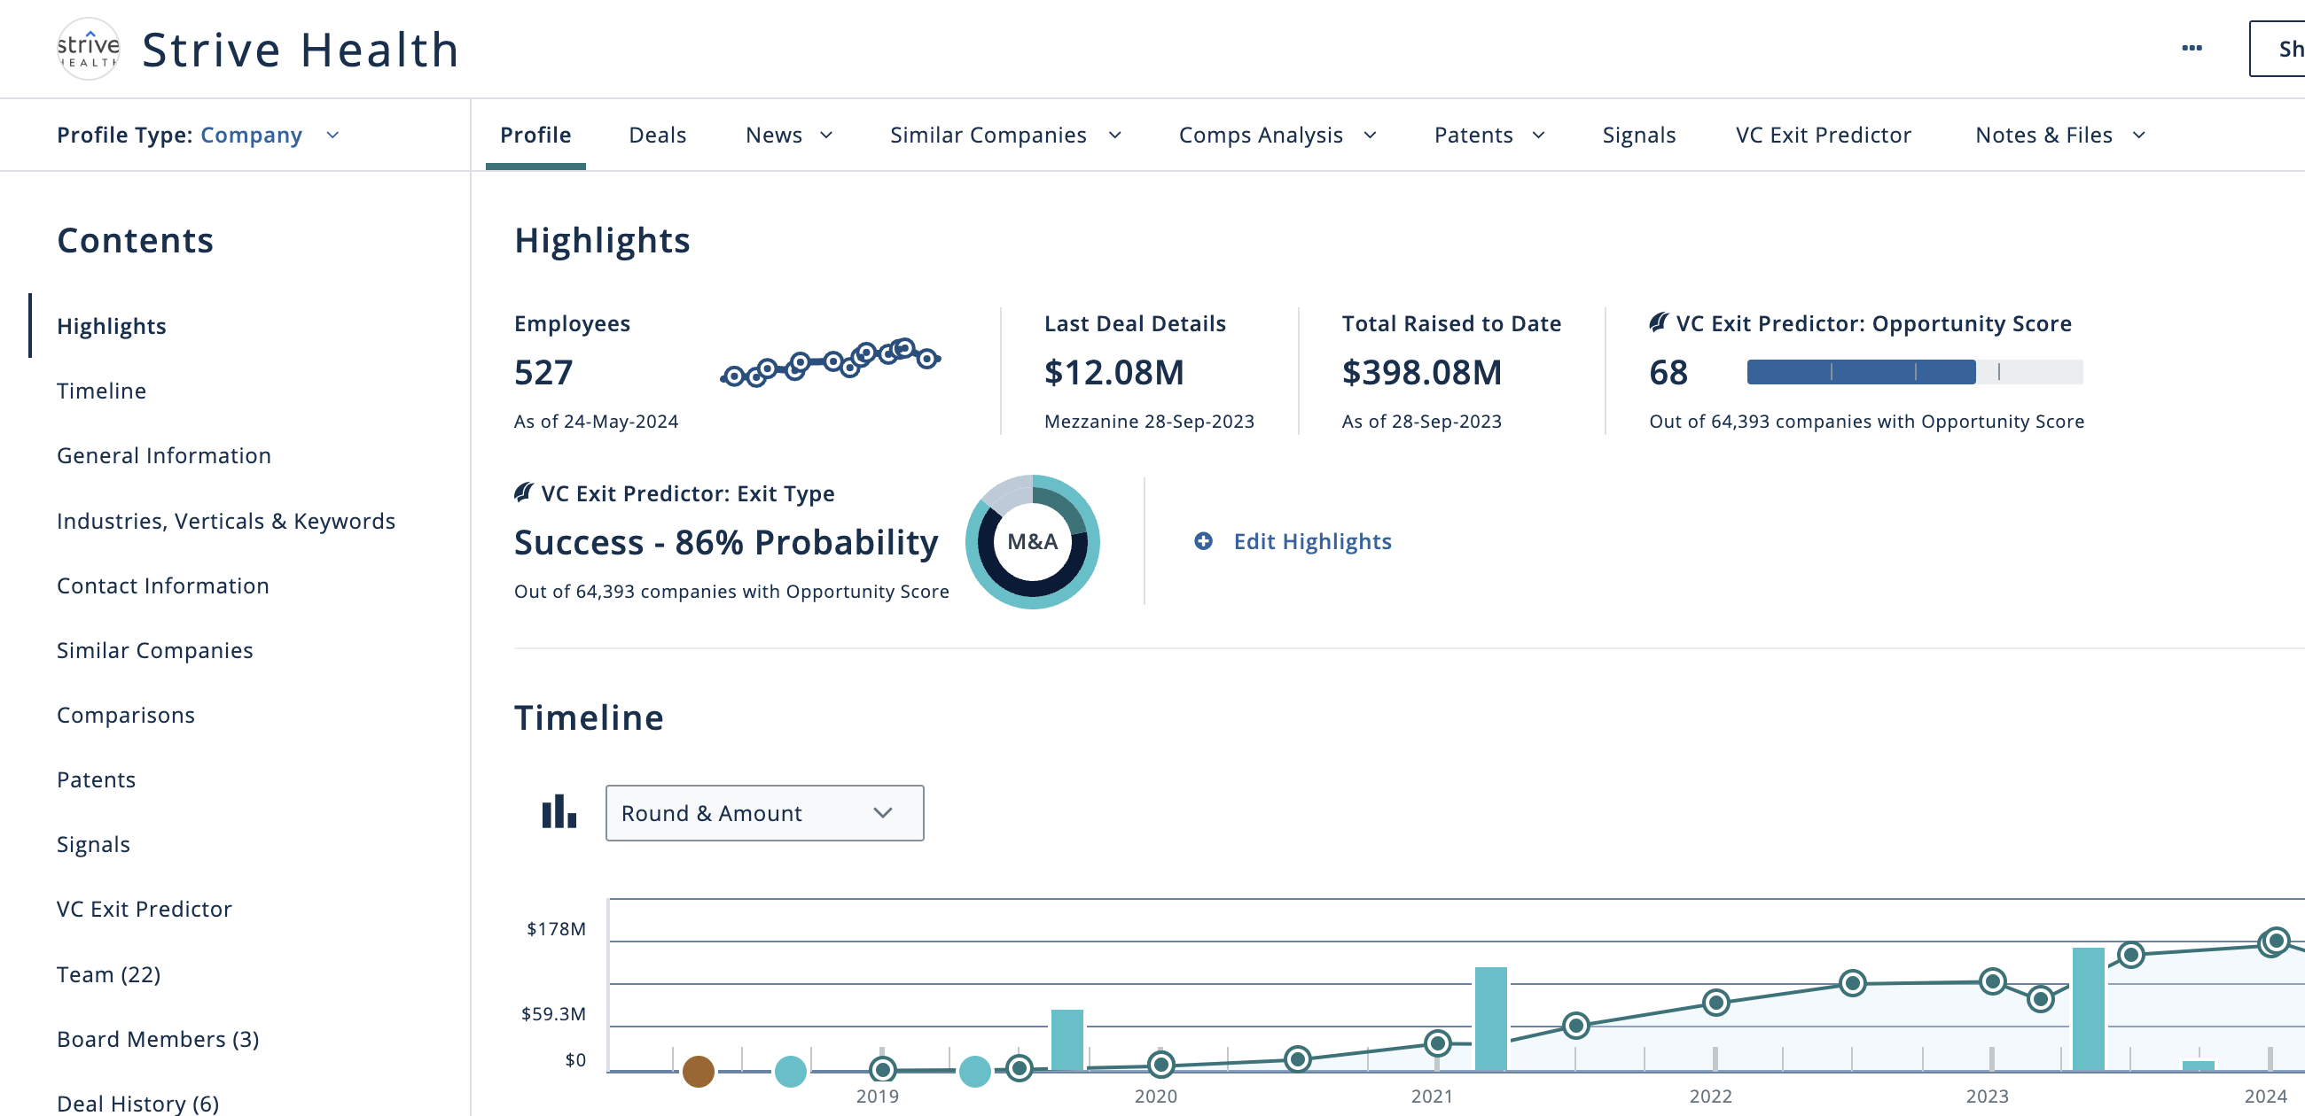
What happened here?
Notes:
(Talk about Strive) manage CKD/ESRD. ML models to predict ESRD progression. “Delegated risk”.
What the hell happened in ’21? CMS: ESRD patients can elect an MA plan. Like 100K new patients enrolling in MA. Roughly $100K per year per patient.

Slide 72


Slide 73
EOL

